Slide 1
IT Infrastructure Architecture
Infrastructure Building Blocks
and Concepts
Hosting and deployment options
(chapter 13 - 14)

Slide 2
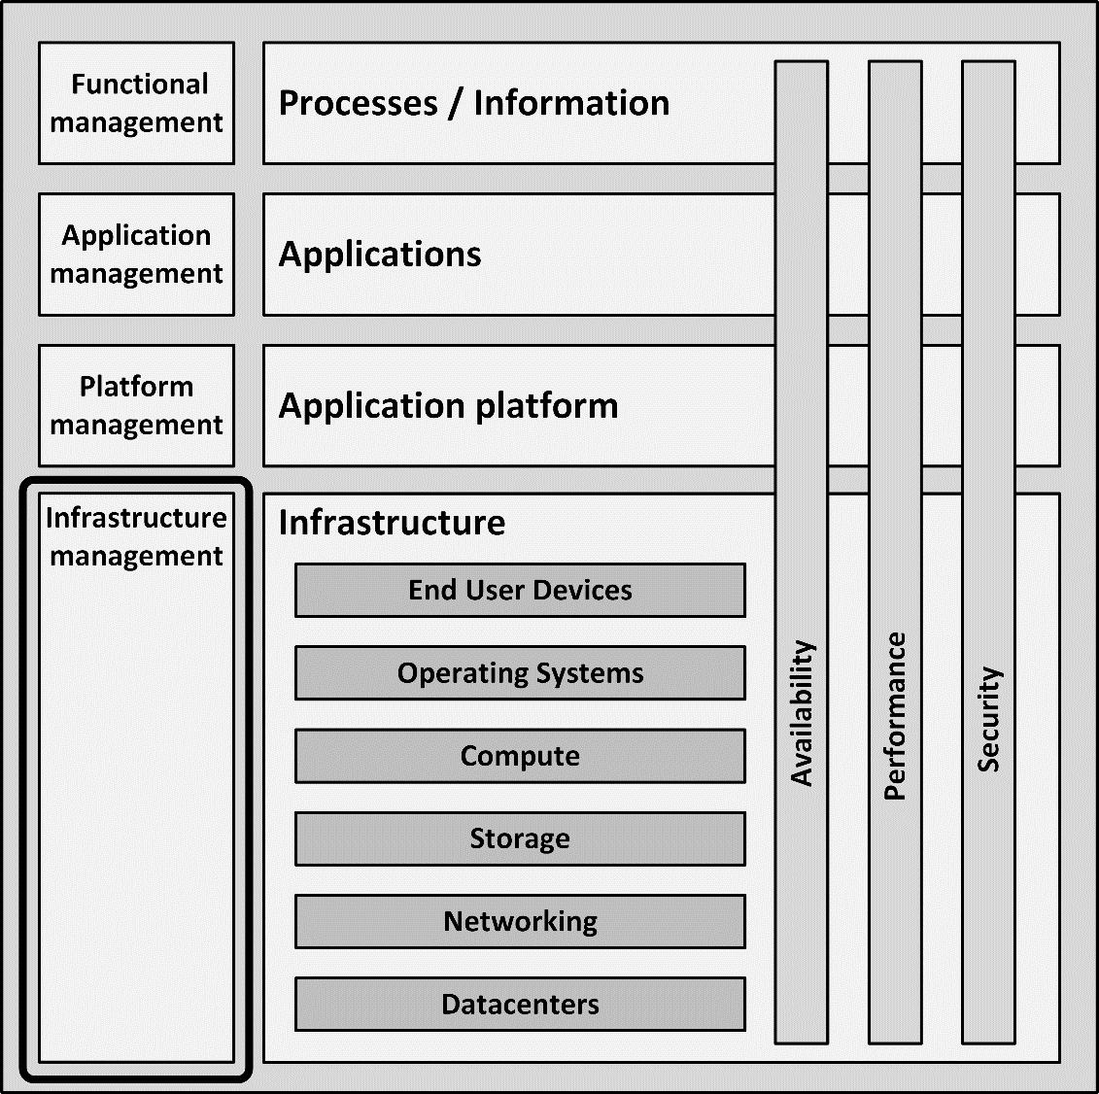
Introduction
This part is about the systems management processes to determine the best deployment option for the infrastructure

Slide 3
Hosting options
Hosting options define where infrastructure is deployed
Deployment models define how infrastructure is deployed
Infrastructure can be hosted:
On-premises
In a colocation
Outsourced

Slide 4
On-premises hosting
Infrastructure components run on the premises of the organization using the infrastructure
In the datacenter of an existing building
In a dedicated, specially designed datacenter building
The building must have:
Enough space
An uninterruptable power supply (UPS)
Options to install sufficient cooling
Fire prevention and detection
External redundant network capabilities with enough bandwidth
Sufficient floor loading capacity

Slide 5
On-premises hosting
Drawbacks:
On-premises datacenters don’t scale well, as they are embedded in existing (office) buildings
The organization must have enough knowledge and staff available to manage the datacenter

Slide 6
Colocation
A third party dedicated datacenter where racks, floor space, and network bandwidth can be rented
Hosts and connects customer owned infrastructure components
Provides:
Power
Cooling
Physical security
Racks are empty – all infrastructure components must be provided and managed by the organization renting the colocation racks

Slide 7
Outsourcing
Full infrastructure outsourcing is a subcontracting service in which some third-party purchases, deploys, hosts, and manages the infrastructure, and performs its lifecycle management
Managed using Service Level Agreements
Very rigid change management process
Frees the organization from investing in hardware
Only operational cost
The outsourcing organization must have:
A demand organization
A process to manage the outsourcing party
The outsourcing organization can be freed from internal infrastructure systems managers

Slide 8
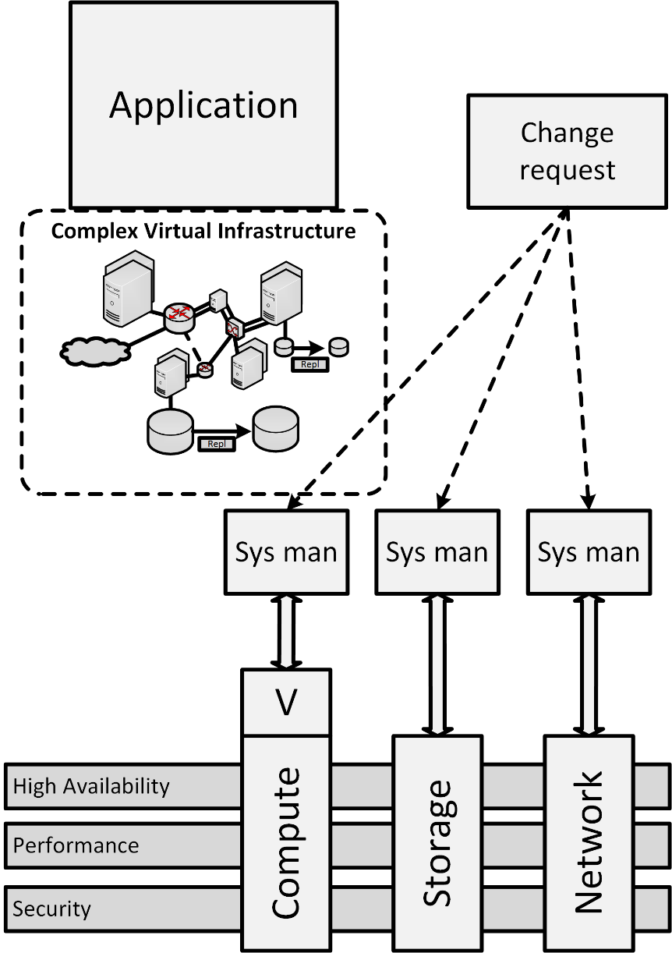
Enterprise infrastructure deployment
A traditional enterprise infrastructure deployment
Enterprise grade hardware delivers three infrastructure resources:
Compute
Storage
Network
Provides:
High availability
High performance
Some security controls

Slide 9
Enterprise infrastructure deployment
Most enterprise infrastructure deployments implement compute virtualization to provide virtual machines
Each resource is managed by a team of dedicated systems managers
Changes are managed by a workflow based change process
Each systems manager is responsible to manually perform his part of the change

Slide 10
Enterprise infrastructure deployment
Enterprise infrastructures can deliver complex virtual infrastructures to applications
The virtual infrastructure is designed to meet the requirements of applications
Applications depend on the high availability, performance and security controls delivered by the infrastructure

Slide 11
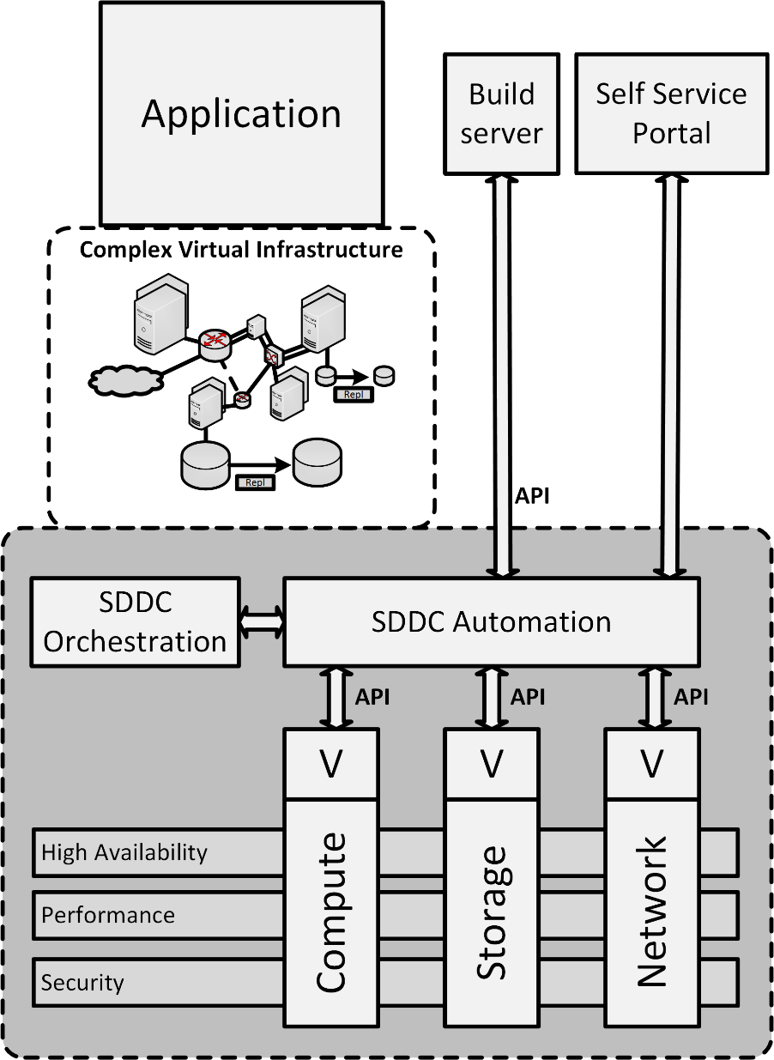
Software-defined datacenter - SDDC
A software-defined datacenter (SDDC) is an architecture in which all infrastructure resources – compute, storage and networking – are virtualized, and can be configured using software APIs
An SDDC is an extension of an enterprise infrastructure
All resources are virtualized and managed by SDDC automation and orchestration software

Slide 12
Software-defined datacenter - SDDC
An SDDC is characterized by:
Automation
Orchestration
Abstraction of resources into software and code
Changes are managed by an automated workflow
An orchestrated change can lead to a number of automated changes in various resources

Slide 13
Software-defined datacenter - SDDC
An SDDC is the foundation for cloud computing
Developers, DevOps teams and systems managers can create and deploy new infrastructures using:
A manual self-service portal
A combination of a build server and APIs
Allows the user to request:
Desired infrastructure components
Their sizing to meet performance demands
Their required availability

Slide 14
Software-defined datacenter - SDDC
SDDC software provides tools for:
Costing
Logging
Reporting
Scaling (up and down)
Decommissioning of the infrastructure resources
Examples of SDDC automation and orchestration products:
OpenStack Horizon
IBM Cloud Orchestrator
VMware vRealize

Slide 15
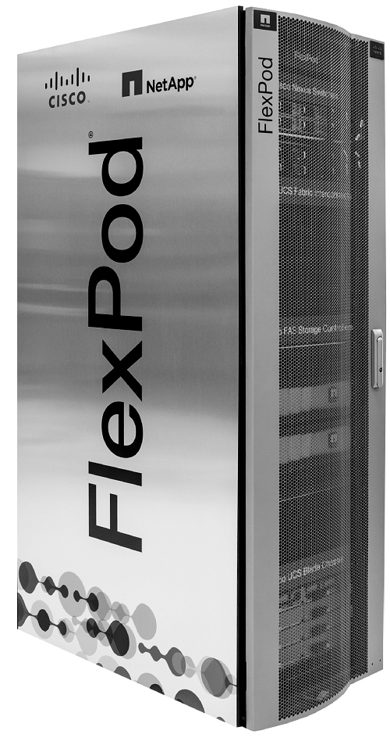
Converged Infrastructure
Compute, storage, and network components are designed, assembled, and delivered by one vendor and managed as one system, typically deployed in one or more racks

Slide 16
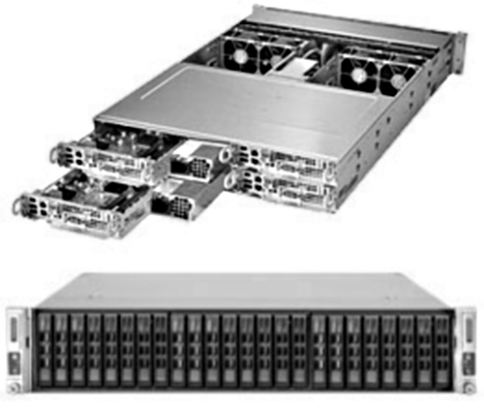
Hyperconverged Infrastructure
Compute, storage, and network components are implemented within a single server node
A hyperconverged infrastructure comprises:
A large number of identical physical servers from one vendor
Direct attached storage in the server
Special software that manages all servers, storage, and networks as one cluster running virtual machines

Slide 17
Hyperconverged Infrastructure
The technology is easy to expand on-demand, by adding nodes to the hyperconverged cluster
Hyperconverged systems are an ideal candidate for deploying VDI environments
Storage is close to compute (in the same node)
Scales well with the rise in the number of users (add more nodes)

Slide 18
(Hyper)converged Infrastructure
Advantages:
Only one vendor
All updates for compute, storage and networking in one service pack
Easy scalable
Disadvantages:
Vendor lock-in – the solution is only beneficial if all infrastructure is from the same vendor
Scaling can only be done in fixed building blocks
If more storage is needed, compute must also be purchased

Slide 19
Cloud computing
Cloud computing is one of the most important paradigm shifts in computing in recent years
Definition NIST:
Cloud computing is a model for enabling ubiquitous, convenient, on-demand network access to a shared pool of configurable computing resources that can be rapidly provisioned and released with minimal management effort or service provider interaction
Cloud computing is an outsourcing model, in which IT services are provided and paid based on actual on-demand use

Slide 20
Cloud characteristics
On demand self-service – End uses can configure, deploy, start and stop systems or applications on demand
Rapid elasticity – A cloud is able to quickly scale-up and scale-down resources, leading to elasticity of resources
Resource pooling – Instead of providing each application with a fixed amount of processing power and storage, cloud computing provides applications with resources from a shared pool
Measured service – The actual resource usage is measured and billed. There are no capital expenses, only operational expenses
Broad network access – Capabilities are available over the network and accessed through standard mechanisms

Slide 21
Cloud deployment models
A public cloud is accessible through the internet, and available to the general public
A private cloud is operated solely for a single organization, whether managed internally or by a third-party, and hosted either on premises or external
A community cloud is much like a private cloud, but shared with a community of organizations that have shared concerns
In a hybrid cloud deployment, a service or application is provided by a combination of a public cloud, and a community cloud and/or a private cloud

Slide 22
Cloud service models
Software-as-a-Service (SaaS) delivers full applications that need little or no configuration
Microsoft Office365, LinkedIn, Facebook, Twitter, and Salesforce.com
Platform-as-a-Service (PaaS) delivers a scalable, high available, open programming platform that can be used by developers to build bespoke applications that run on the PaaS platform
Microsoft Azure Cloud Service and Google App Engine
Infrastructure-as-a-Service (IaaS) delivers virtual machines, networking, and storage
Amazon Elastic Cloud (EC2 and S3) and Microsoft Azure IaaS

Slide 23
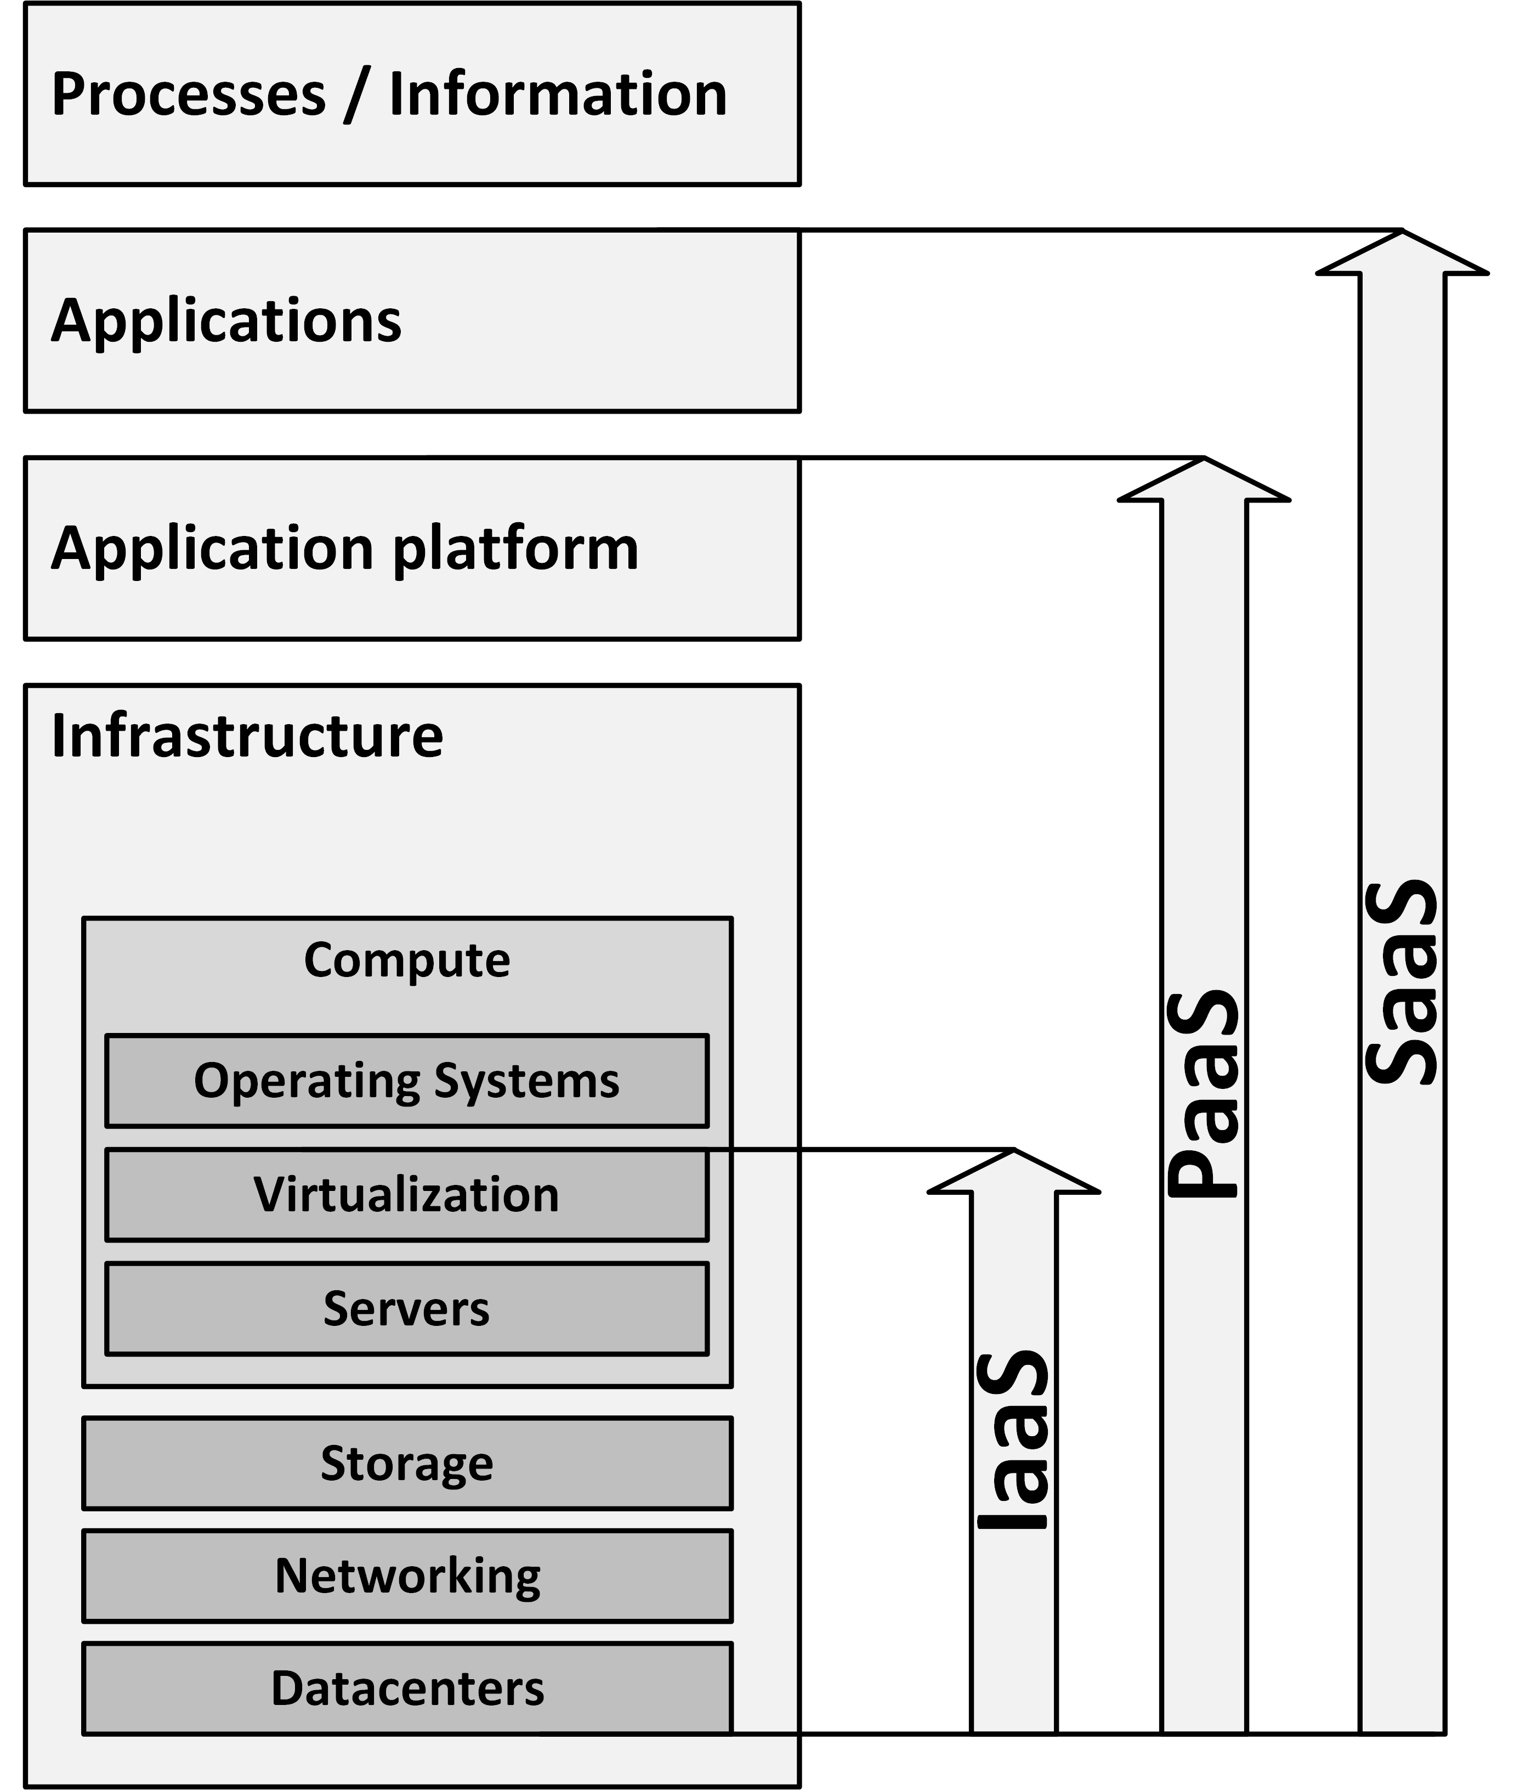
Cloud service models

Slide 24
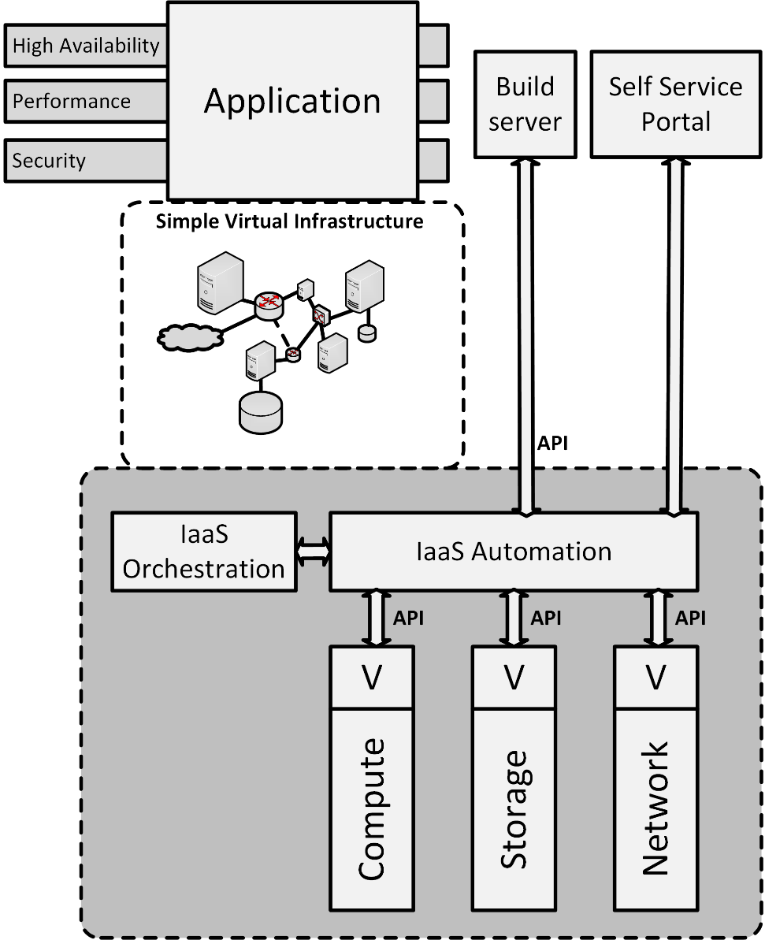
Infrastructure as a Service (IaaS)
Provides:
Virtual machines
Virtualized storage
Virtualized networking
Systems management tools to manage them

Slide 25
Infrastructure as a Service (IaaS)
Failure of the infrastructure is acceptable:
Based on cheap commodity white label hardware
The philosophy is to keep the cost down by allowing the hardware to fail every now and then
Failed components are either replaced or simply removed from the pool of available resources

Slide 26
Infrastructure as a Service (IaaS)
IaaS provides simple, highly standardized building blocks to applications
Does not provide high availability, guaranteed performance or extensive security controls
Applications should be:
Robust to allow for failing hardware
Horizontally scalable to increase performance

Slide 27
Infrastructure as a Service (IaaS)
To use IaaS, users must create and start a new server, and then install an operating system and their applications
The cloud provider only provides basic services, like billing and monitoring
The user is responsible for patching and maintaining the operating systems and application software
Not all operating systems and applications can be used in an IaaS cloud
Many software licenses prohibit the use of a fully scalable, virtual environment like IaaS

Slide 28
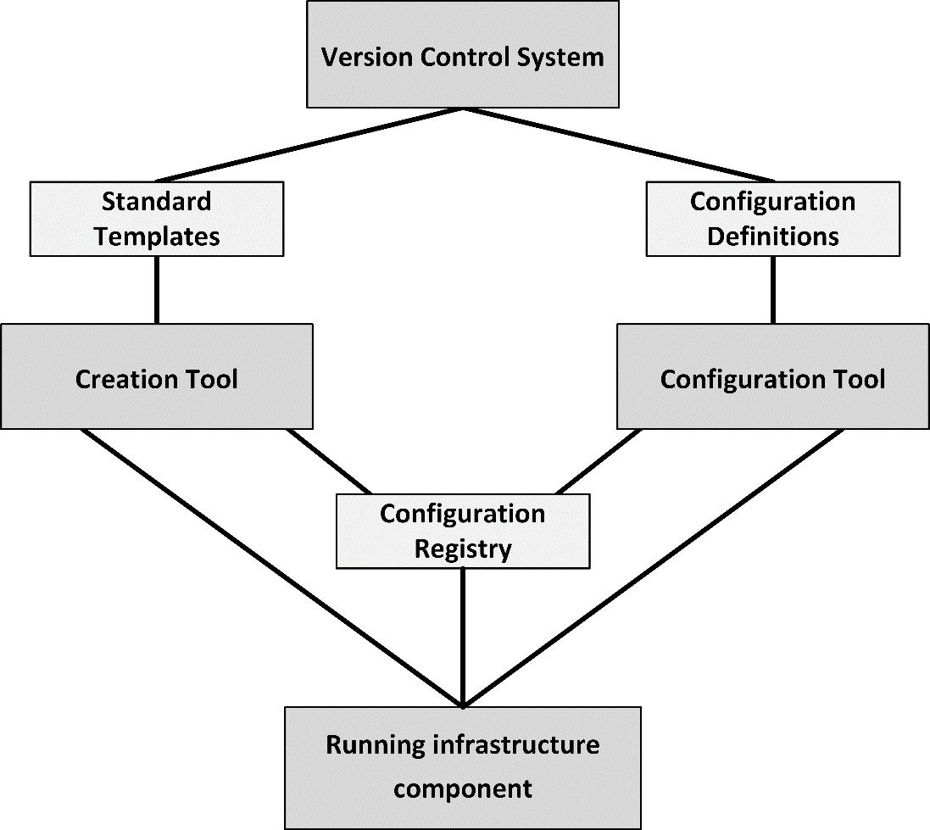
Infrastructure as code
In infrastructure as code, servers, storage, and networks can be created and configured automatically
Tools to implement infrastructure as code include:
Puppet
Chef
Ansible
SaltStack
Terraform

Slide 29
Infrastructure as code
Infrastructure as code ensures all infrastructure components that should be equal, are equal.
Standard templates are defined that describe the basic setup of infrastructure components
Configurations of infrastructure components are defined in configuration definitions
New instances of infrastructure components can be created automatically by a creation tool
Using the standard templates
Leads to a running, unconfigured infrastructure component

Slide 30
Infrastructure as code
After an infrastructure component is created, the configuration tool automatically configures it
Based on the configuration definitions
Leads to a running, configured infrastructure component
When the new infrastructure component is created and configured, its properties are automatically stored in the configuration registry
DNS name
Is the server is part of a load balancer pool?

Slide 31
Infrastructure as code
The configuration registry allows running instances of infrastructure to recognize and find each other
It ensures all needed components are running
Configuration definition files and standard templates are kept in a version control system
Enables roll backs and rolling upgrades

